Slide 1
CSDS 451: Designing High Performant Systems for AI
Lecture 17
10/28/2025
Sanmukh Kuppannagari
sanmukh.kuppannagari@case.edu
https://sanmukh.research.st/
Case Western Reserve University

Slide 2
Outline
Sparse Transformers Basics
Sparse Masks

Slide 3
Outline
Sparse Transformers Basics
Sparse Masks

Slide 4

Attention Mechanism – Fast Facts
Three Key Operations
Operation #1: $Y= QK^{T}$: Product of $Q$ and $K^{T}$
Operation #2: $Z=Softmax(Y)$
Operation #3: $O=ZV$: Product of $Z$ and $V$ matrices
$Q,K^{T}, V, Z$: Dense matrices

Slide 5








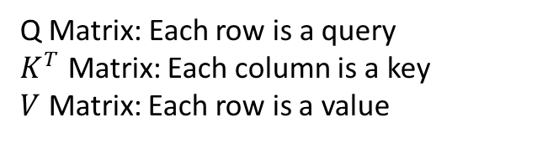










Attention
$$Attention(Q,K,V)$$
$$d_{k}$$
$$d_{v}$$
$$q_{1}$$
$$v_{1}$$
$$q_{2}$$
$$v_{2}$$
$$q_{3}$$
$$v_{3}$$
Softmax
$$L$$
X
$$k_{1}$$
$$k_{2}$$
$$k_{3}$$
$$k_{L}$$
$$d_{k}$$
X
$$L$$
$$q_{L}$$
$$v_{L}$$
$$L$$
Q Matrix: Each row is a query
$K^{T}$ Matrix: Each column is a key
$V$ Matrix: Each row is a value
X: Matrix MM

Slide 6























Zooming into Attention
$$d_{k}$$
$$q_{1}$$
$$q_{1}.k_{1}$$
$$q_{1}.k_{2}$$
…
$$q_{1}.k_{L}$$
$$q_{2}$$
$$q_{3}$$
$$q_{2}.k_{1}$$
$$q_{2}.k_{2}$$
…
$$q_{2}.k_{L}$$
$$L$$
X
$$k_{1}$$
$$k_{2}$$
$$k_{3}$$
$$k_{L}$$
$$d_{k}$$
=
$$L$$
$$q_{L}$$
$$q_{L}.k_{1}$$
$$q_{L}.k_{2}$$
…
$$q_{L}.k_{L}$$
$$L$$
$$L$$

Slide 7





















Zooming into Attention
$$q_{1}.k_{1}$$
$$q_{1}.k_{2}$$
…
$$w_{11}$$
$$w_{12}$$
…
$$w_{1L}$$
$$q_{2}.k_{1}$$
$$q_{2}.k_{2}$$
…
$$q_{2}.k_{L}$$
$$w_{21}$$
$$w_{22}$$
…
$$w_{2L}$$
=
Softmax
$$L$$
$$L$$
$$q_{L}.k_{1}$$
$$q_{L}.k_{2}$$
…
$$q_{L}.k_{L}$$
$$w_{L1}$$
$$w_{L2}$$
…
$$w_{LL}$$
$$L$$
$$L$$
$$\left[w_{i1}, w_{i2}, …,w_{iL}\right]=softmax([q_{1}.k_{1},q_{1}.k_{2}, …,q_{1}.k_{L}])$$

Slide 8
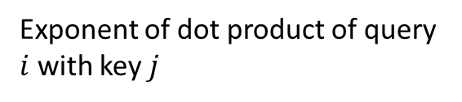
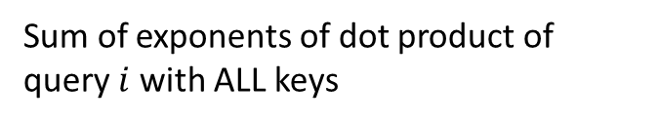
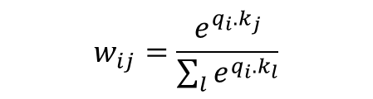
Zooming into Attention
$$q_{1}.k_{1}$$
$$q_{1}.k_{2}$$
…
$$w_{11}$$
$$w_{12}$$
…
$$w_{1L}$$
$$q_{2}.k_{1}$$
$$q_{2}.k_{2}$$
…
$$q_{2}.k_{L}$$
$$w_{21}$$
$$w_{22}$$
…
$$w_{2L}$$
=
Softmax
$$L$$
$$L$$
$$q_{L}.k_{1}$$
$$q_{L}.k_{2}$$
…
$$q_{L}.k_{L}$$
$$w_{L1}$$
$$w_{L2}$$
…
$$w_{LL}$$
$$L$$
$$L$$
$$\left[w_{i1}, w_{i2}, …,w_{iL}\right]=softmax\left(\left[q_{i}.k_{1},q_{i}.k_{2}, …,q_{i}.k_{L}\right]\right)$$
Exponent of dot product of query $i$ with key $j$
$$w_{ij}=\frac{e^{q_{i}.k_{j}}}{\sum_{l}{e^{q_{i}.k_{l}}}}$$
Sum of exponents of dot product of query $i$ with ALL keys

Slide 9























Zooming into Attention
$$d_{v}$$
$$d_{v}$$
$$w_{11}$$
$$w_{12}$$
…
$$w_{1L}$$
$$v_{1}$$
$${w_{11}v}_{1}+w_{12}v_{2}+ …+w_{1L}v_{L}$$
$$v_{2}$$
$${w_{21}v}_{1}+w_{22}v_{2}+ …+w_{2L}v_{L}$$
$$w_{21}$$
$$w_{22}$$
…
$$w_{2L}$$
$$v_{3}$$
$${w_{31}v}_{1}+w_{32}v_{2}+ …+w_{3L}v_{L}$$
$$L$$
X
$$L$$
=
$$L$$
$$v_{L}$$
$${w_{L1}v}_{1}+w_{L2}v_{2}+ …+w_{LL}v_{L}$$
$$w_{L1}$$
$$w_{L2}$$
…
$$w_{LL}$$
$$L$$

Slide 10




Zooming into Attention
$$d_{v}$$
$$d_{v}$$
$$w_{11}$$
$$w_{12}$$
…
$$w_{1L}$$
$$v_{1}$$
$$o_{1}$$
$$v_{2}$$
$$o_{2}$$
$$w_{21}$$
$$w_{22}$$
…
$$w_{2L}$$
$$v_{3}$$
$$o_{3}$$
$$L$$
X
$$L$$
=
$$L$$
$$v_{L}$$
$$o_{L}$$
$$w_{L1}$$
$$w_{L2}$$
…
$$w_{LL}$$
$$L$$

Slide 11
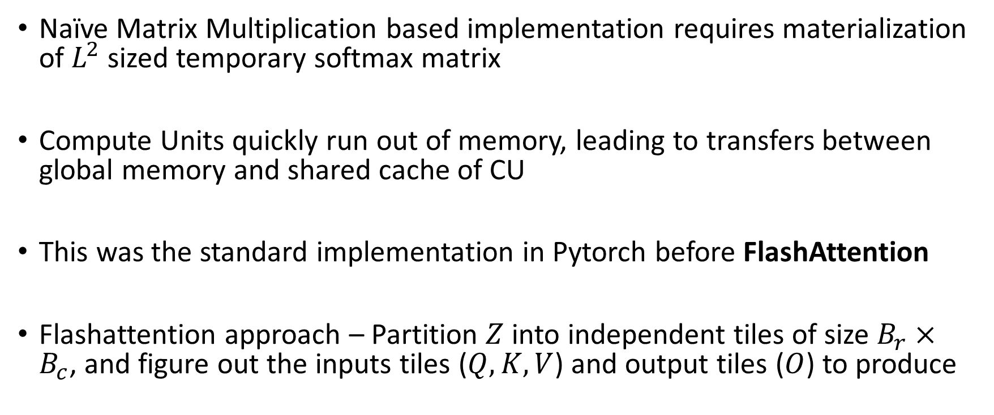
Attention Mechanism – Fast Facts
Naïve Matrix Multiplication based implementation requires materialization of $L^{2}$ sized temporary softmax matrix
Compute Units quickly run out of memory, leading to transfers between global memory and shared cache of CU
This was the standard implementation in Pytorch before FlashAttention
Flashattention approach – Partition $Z$ into independent tiles of size $B_{r}×B_{c}$, and figure out the inputs tiles ($Q,K,V$) and output tiles ($O$) to produce

Slide 12






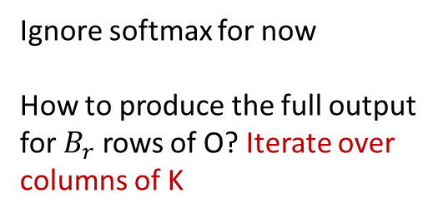






























FlashAttention
$${w_{11}v}_{1}+w_{12}v_{2}+ …+w_{1L}v_{L}$$
$${w_{21}v}_{1}+w_{22}v_{2}+ …+w_{2L}v_{L}$$
$$B_{r}$$
$${w_{31}v}_{1}+w_{32}v_{2}+ …+w_{3L}v_{L}$$
Ignore softmax for now
How to produce the full output for $B_{r}$ rows of O? Iterate over columns of K
$$k_{1}$$
$$k_{2}$$
$$k_{3}$$
$$k_{L}$$
$$L$$
$${w_{L1}v}_{1}+w_{L2}v_{2}+ …+w_{LL}v_{L}$$
$$B_{c}$$
=
$$d_{v}$$
$$q_{1}$$
$$w_{11}$$
$$w_{12}$$
$$w_{13}$$
…
$$w_{1L}$$
$$v_{1}$$
$$q_{2}$$
$$B_{r}$$
$$v_{2}$$
$$B_{c}$$
$$w_{21}$$
…
$$w_{2L}$$
$$v_{3}$$
$$w_{22}$$
$$w_{23}$$
$$L$$
X
$$q_{L}$$
…
$$w_{LL}$$
$$v_{L}$$
$$w_{L1}$$
$$w_{L2}$$
$$w_{L3}$$
Memory Needed: $B_{r}×B_{c}+d_{k}B_{r}+d_{k}B_{c}+d_{v}B_{c}+d_{v}B_{r}$
$$L$$
$$d_{v}$$

Slide 13




FlashAttention
$${w_{11}v}_{1}+w_{12}v_{2}+ …+w_{1L}v_{L}$$
$${w_{21}v}_{1}+w_{22}v_{2}+ …+w_{2L}v_{L}$$
$$B_{r}$$
$${w_{31}v}_{1}+w_{32}v_{2}+ …+w_{3L}v_{L}$$
Ignore softmax for now
How to produce the full output for $B_{r}$ rows of O? Iterate over columns of K
$$k_{1}$$
$$k_{2}$$
$$k_{3}$$
$$k_{L}$$
$$L$$
$${w_{L1}v}_{1}+w_{L2}v_{2}+ …+w_{LL}v_{L}$$
=
$$B_{c}$$
$$d_{v}$$
$$q_{1}$$
$$w_{11}$$
$$w_{12}$$
$$w_{13}$$
…
$$w_{1L}$$
$$v_{1}$$
$$q_{2}$$
$$B_{r}$$
$$v_{2}$$
$$w_{21}$$
…
$$w_{2L}$$
$$v_{3}$$
$$w_{22}$$
$$w_{23}$$
$$L$$
$$B_{c}$$
X
$$q_{L}$$
…
$$w_{LL}$$
$$v_{L}$$
$$w_{L1}$$
$$w_{L2}$$
$$w_{L3}$$
Memory Needed: $B_{r}×B_{c}+d_{k}B_{r}+d_{k}B_{c}+d_{v}B_{c}+d_{v}B_{r}$
$$L$$
$$d_{v}$$

Slide 14




FlashAttention
$${w_{11}v}_{1}+w_{12}v_{2}+ …+w_{1L}v_{L}$$
$${w_{21}v}_{1}+w_{22}v_{2}+ …+w_{2L}v_{L}$$
$$B_{r}$$
$${w_{31}v}_{1}+w_{32}v_{2}+ …+w_{3L}v_{L}$$
Ignore softmax for now
How to produce the full output for $B_{r}$ rows of O? Iterate over columns of K
$$k_{1}$$
$$k_{2}$$
$$k_{3}$$
$$k_{L}$$
$$L$$
$${w_{L1}v}_{1}+w_{L2}v_{2}+ …+w_{LL}v_{L}$$
=
$$B_{c}$$
$$d_{v}$$
$$q_{1}$$
$$w_{11}$$
$$w_{12}$$
$$w_{13}$$
…
$$w_{1L}$$
$$v_{1}$$
$$q_{2}$$
$$B_{r}$$
$$v_{2}$$
$$w_{21}$$
…
$$w_{2L}$$
$$v_{3}$$
$$w_{22}$$
$$w_{23}$$
$$L$$
X
$$q_{L}$$
$$B_{c}$$
…
$$w_{LL}$$
$$v_{L}$$
$$w_{L1}$$
$$w_{L2}$$
$$w_{L3}$$
Memory Needed: $B_{r}×B_{c}+d_{k}B_{r}+d_{k}B_{c}+d_{v}B_{c}+d_{v}B_{r}$
$$L$$
$$d_{v}$$

Slide 15







FlashAttention
$${w_{11}v}_{1}+w_{12}v_{2}+ …+w_{1L}v_{L}$$
$${w_{21}v}_{1}+w_{22}v_{2}+ …+w_{2L}v_{L}$$
$${w_{31}v}_{1}+w_{32}v_{2}+ …+w_{3L}v_{L}$$
Ignore softmax for now
How to produce the full output for $B_{r}$ rows of O? Iterate over columns of K
$$k_{1}$$
$$k_{2}$$
$$k_{3}$$
$$k_{L}$$
$$L$$
$${w_{L1}v}_{1}+w_{L2}v_{2}+ …+w_{LL}v_{L}$$
$$B_{r}$$
$$B_{c}$$
=
$$d_{v}$$
$$q_{1}$$
$$w_{11}$$
$$w_{12}$$
$$w_{13}$$
…
$$w_{1L}$$
$$v_{1}$$
$$q_{2}$$
$$v_{2}$$
$$B_{c}$$
$$w_{21}$$
…
$$w_{2L}$$
$$v_{3}$$
$$w_{22}$$
$$w_{23}$$
$$B_{c}$$
$$L$$
X
$$q_{L}$$
$$B_{r}$$
…
$$w_{LL}$$
$$v_{L}$$
$$w_{L1}$$
$$w_{L2}$$
$$w_{L3}$$
$$L$$
$$d_{v}$$

Slide 16




FlashAttention
$${w_{11}v}_{1}+w_{12}v_{2}+ …+w_{1L}v_{L}$$
$${w_{21}v}_{1}+w_{22}v_{2}+ …+w_{2L}v_{L}$$
$${w_{31}v}_{1}+w_{32}v_{2}+ …+w_{3L}v_{L}$$
Ignore softmax for now
How to produce the full output for $B_{r}$ rows of O? Iterate over columns of K
$$k_{1}$$
$$k_{2}$$
$$k_{3}$$
$$k_{L}$$
$$L$$
$${w_{L1}v}_{1}+w_{L2}v_{2}+ …+w_{LL}v_{L}$$
$$B_{r}$$
=
$$d_{v}$$
$$q_{1}$$
$$w_{11}$$
$$w_{12}$$
$$w_{13}$$
…
$$w_{1L}$$
$$v_{1}$$
$$q_{2}$$
$$v_{2}$$
$$w_{21}$$
…
$$w_{2L}$$
$$v_{3}$$
$$w_{22}$$
$$w_{23}$$
$$B_{c}$$
$$L$$
$$B_{c}$$
X
$$q_{L}$$
$$B_{r}$$
…
$$w_{LL}$$
$$v_{L}$$
$$w_{L1}$$
$$w_{L2}$$
$$w_{L3}$$
$$L$$
$$d_{v}$$

Slide 17




FlashAttention
$${w_{11}v}_{1}+w_{12}v_{2}+ …+w_{1L}v_{L}$$
$${w_{21}v}_{1}+w_{22}v_{2}+ …+w_{2L}v_{L}$$
$${w_{31}v}_{1}+w_{32}v_{2}+ …+w_{3L}v_{L}$$
Ignore softmax for now
How to produce the full output for $B_{r}$ rows of O? Iterate over columns of K
$$k_{1}$$
$$k_{2}$$
$$k_{3}$$
$$k_{L}$$
$$L$$
$${w_{L1}v}_{1}+w_{L2}v_{2}+ …+w_{LL}v_{L}$$
$$B_{r}$$
=
$$d_{v}$$
$$q_{1}$$
$$w_{11}$$
$$w_{12}$$
$$w_{13}$$
…
$$w_{1L}$$
$$v_{1}$$
$$q_{2}$$
$$v_{2}$$
$$w_{21}$$
…
$$w_{2L}$$
$$v_{3}$$
$$w_{22}$$
$$w_{23}$$
$$B_{c}$$
$$L$$
X
$$q_{L}$$
$$B_{r}$$
…
$$w_{LL}$$
$$v_{L}$$
$$B_{c}$$
$$w_{L1}$$
$$w_{L2}$$
$$w_{L3}$$
$$L$$
$$d_{v}$$

Slide 18
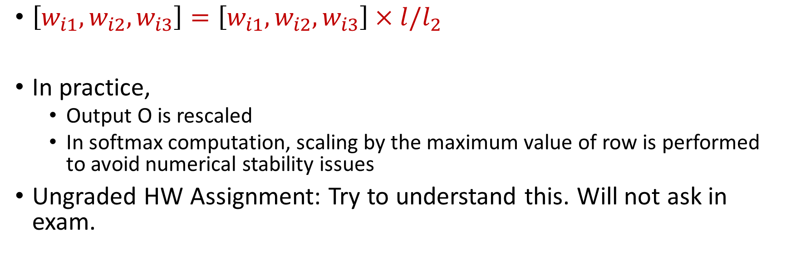
How do we compute “partial” softmaxes
$\left[w_{i1}, w_{i2}, w_{i3}\right]=\left[w_{i1}, w_{i2}, w_{i3}\right]×l/l_{2}$
In practice,
Output O is rescaled
In softmax computation, scaling by the maximum value of row is performed to avoid numerical stability issues
Ungraded HW Assignment: Try to understand this. Will not ask in exam.

Slide 19
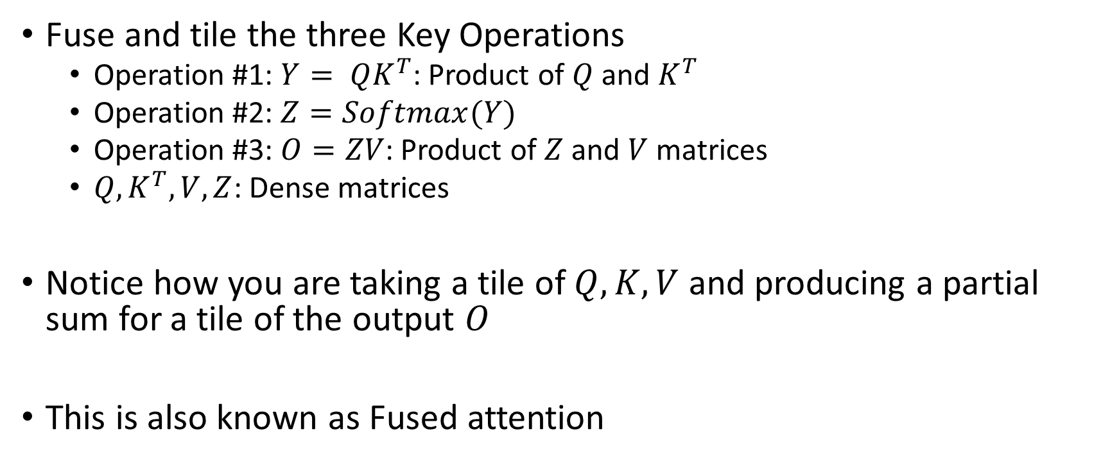
Flash Attention
Fuse and tile the three Key Operations
Operation #1: $Y= QK^{T}$: Product of $Q$ and $K^{T}$
Operation #2: $Z=Softmax(Y)$
Operation #3: $O=ZV$: Product of $Z$ and $V$ matrices
$Q,K^{T}, V, Z$: Dense matrices
Notice how you are taking a tile of $Q, K, V$ and producing a partial sum for a tile of the output $O$
This is also known as Fused attention

Slide 20

Flash attention
Reduces the memory requirements from $O(L^{2})$ to $??$

Slide 21
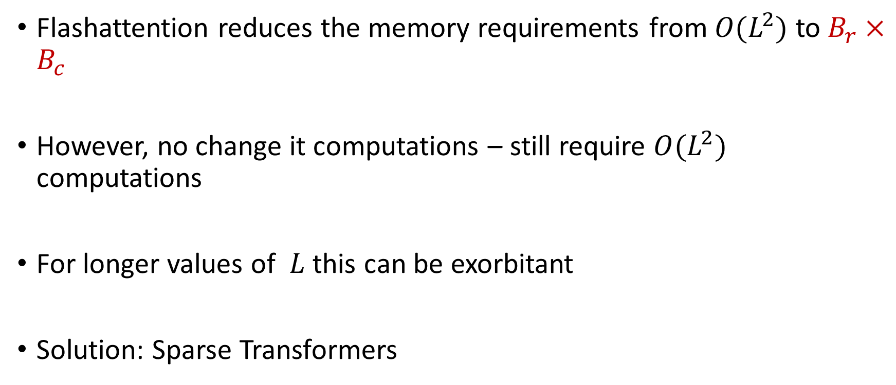
Sparse Transformers
Flashattention reduces the memory requirements from $O(L^{2})$ to $B_{r}×B_{c}$
However, no change it computations – still require $O(L^{2})$ computations
For longer values of $L$ this can be exorbitant
Solution: Sparse Transformers

Slide 22











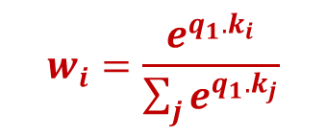




Key Idea
Considering soft-lookup view of attention
Not every query-key pairs need to interact
As keys and queries are projection of tokens -> Not every pair of token need to interact
$$q_{1}.k_{1}$$
$$w_{1}$$
$$q_{1}$$
$$k_{1}$$
$$v_{1}$$
$$w_{i}=\frac{e^{q_{1}.k_{i}}}{\sum_{j}{e^{q_{1}.k_{j}}}}$$
$$q_{1}.k_{2}$$
$$k_{2}$$
$$v_{2}$$
$$w_{2}$$
$$q_{2}$$
$$q_{1}.k_{3}$$
$$k_{3}$$
$$v_{3}$$
$$w_{3}$$
$$q_{L}$$

Slide 23
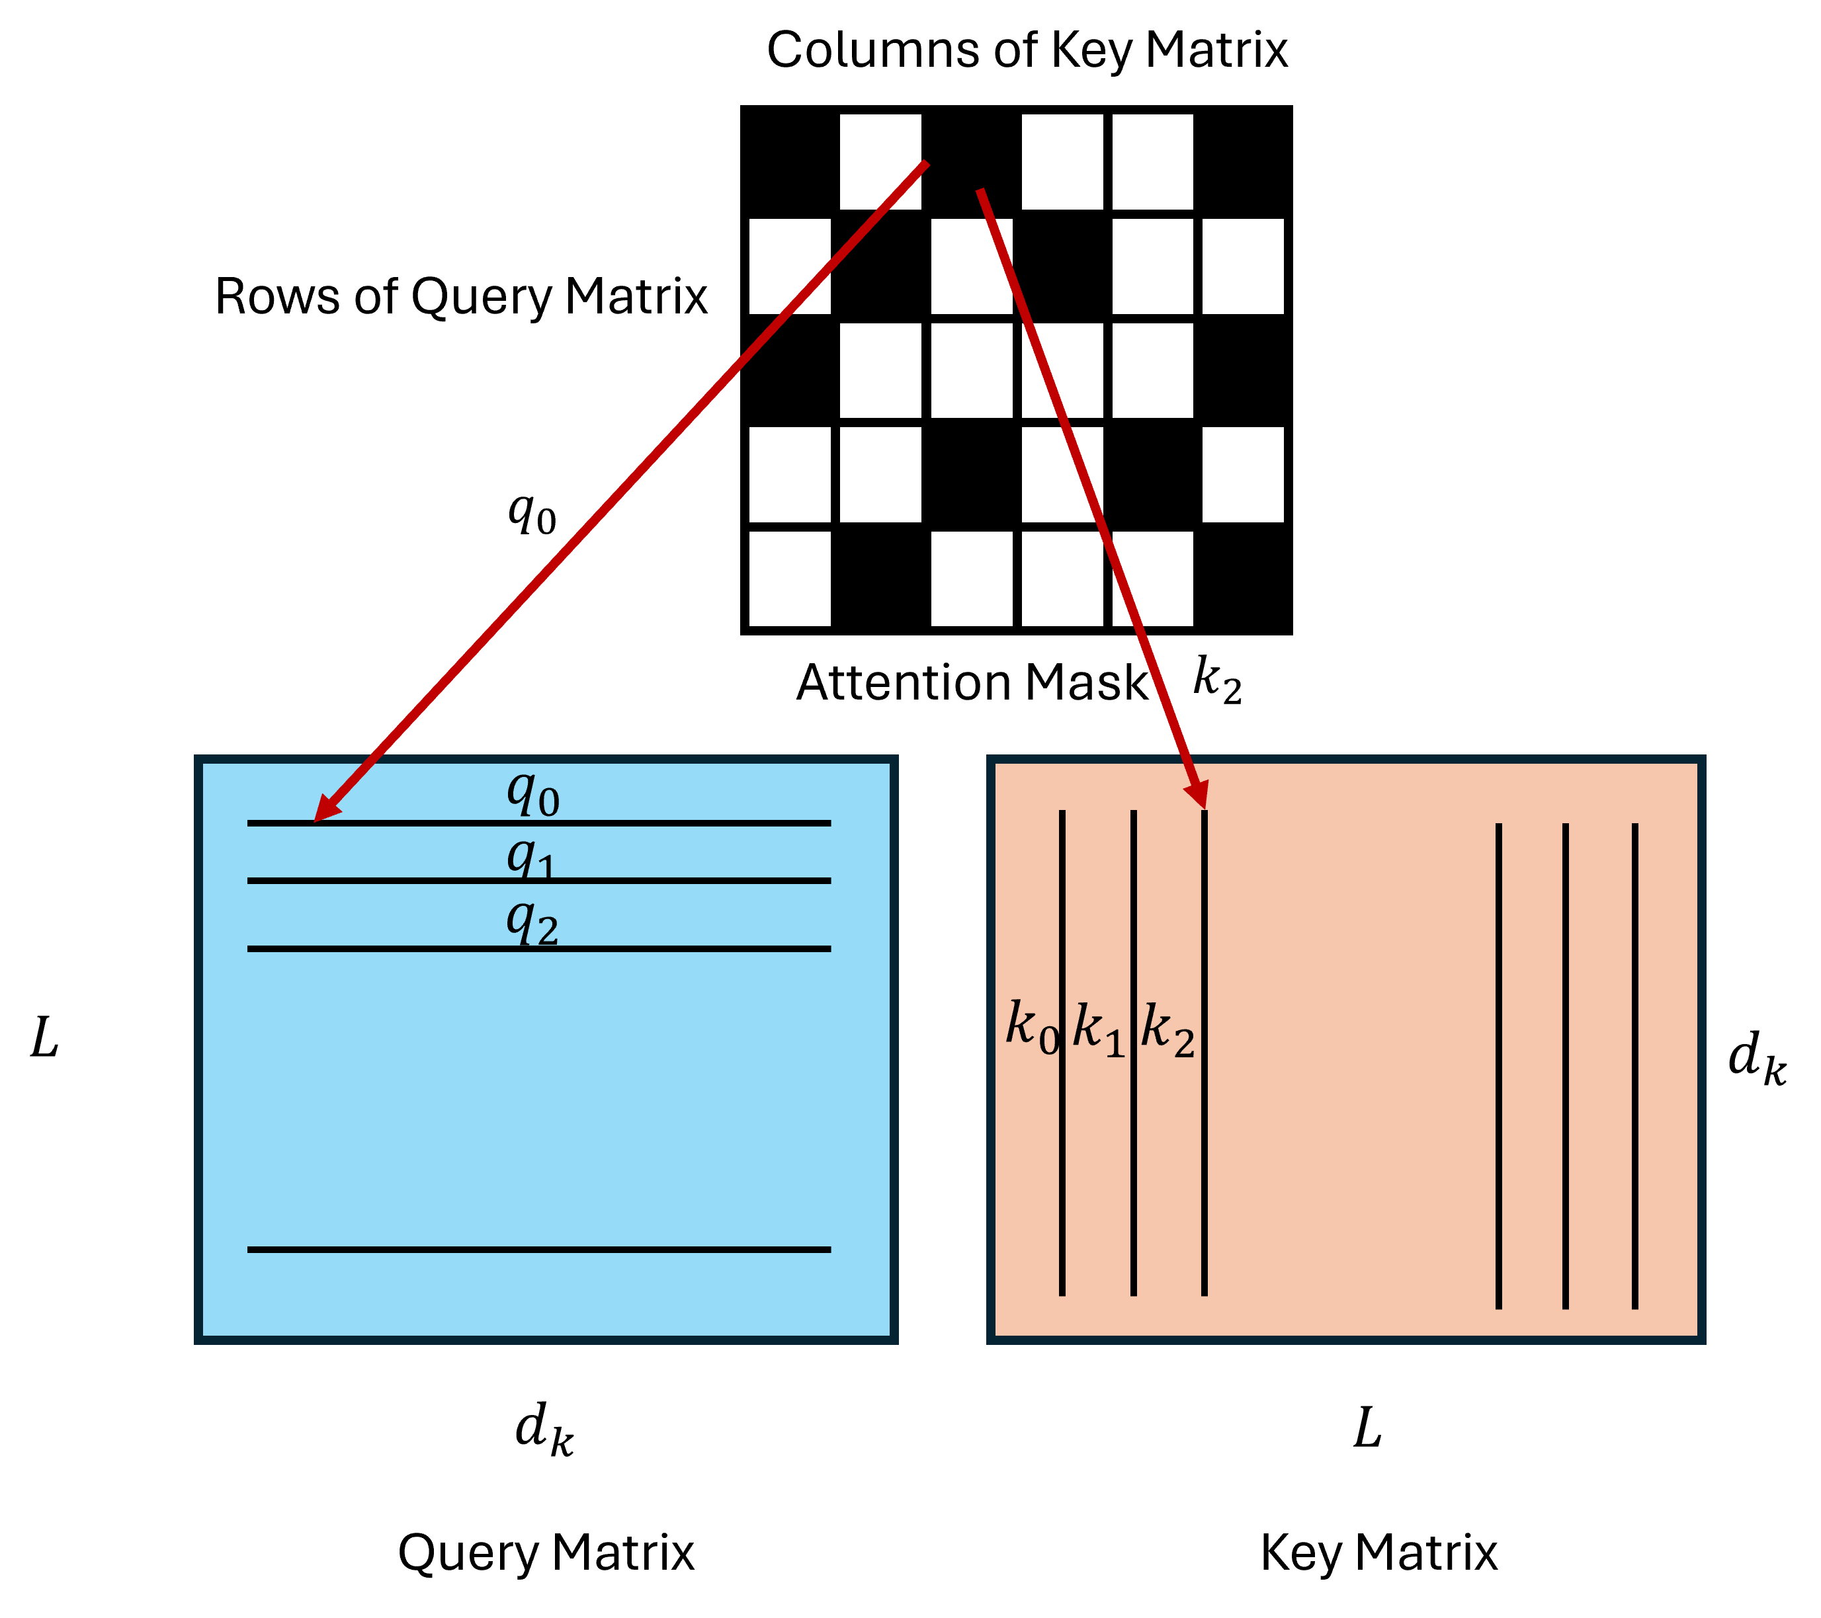
Introducing Sparsity in Attention
Key Idea: Not every pair of query and key/value need to interact
If we represent the query-key interactions as an adjacency matrix, we want to prune the entries of the matrix

Slide 24











Attention Mask
$$x_{1}$$
$$x_{2}$$
$$x_{3}$$
$$x_{L}$$
Self-Attention in Transformer Blocks:
All 1s adjacency matrix
(colored cell is 1)
$$x_{1}$$
$$x_{2}$$
$$q_{i}$$
$$x_{3}$$
X
$$M_{ij}$$
$$k_{j}$$
Each row corresponds to a query
$$x_{L}$$
Each column corresponds to a key

Slide 25




















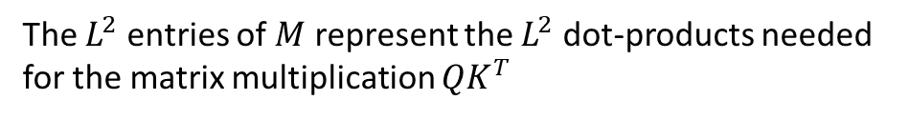
Attention Mask
$$x_{1}$$
$$x_{2}$$
$$x_{3}$$
$$x_{L}$$
$$Q$$
$$K$$
$$x_{1}$$
$$x_{2}$$
$$q_{1}$$
$$x_{3}$$
$$q_{2}$$
$$q_{3}$$
$$L$$
X
$$k_{1}$$
$$k_{2}$$
$$k_{3}$$
$$d_{k}$$
$$x_{L}$$
$$L$$
$$M$$
The $L^{2}$ entries of $M$ represent the $L^{2}$ dot-products needed for the matrix multiplication $QK^{T}$

Slide 26
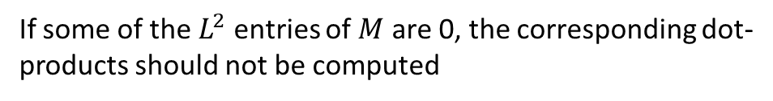
QK Product with Attention Mask
$$x_{1}$$
$$x_{2}$$
$$x_{3}$$
$$x_{L}$$
$$Q$$
$$K$$
$$x_{1}$$
$$x_{2}$$
$$q_{1}$$
$$x_{3}$$
$$q_{2}$$
$$q_{3}$$
$$L$$
X
$$k_{1}$$
$$k_{2}$$
$$k_{3}$$
$$d_{k}$$
$$x_{L}$$
$$L$$
$$M$$
If some of the $L^{2}$ entries of $M$ are 0, the corresponding dot-products should not be computed

Slide 27
QK Product with Attention Mask
$$x_{1}$$
$$x_{2}$$
$$x_{3}$$
$$x_{L}$$
$$Q$$
$$K$$
$$x_{1}$$
$$x_{2}$$
$$q_{1}$$
$$x_{3}$$
$$q_{2}$$
$$q_{3}$$
$$L$$
X
$$k_{1}$$
$$k_{2}$$
$$k_{3}$$
$$x_{L}$$
$$L$$
Do you recall anything from the exam?
$$M$$

Slide 28
QK Product with Attention Mask
$$x_{1}$$
$$x_{2}$$
$$x_{3}$$
$$x_{L}$$
$$Q$$
$$K$$
$$x_{1}$$
$$x_{2}$$
$$q_{1}$$
$$x_{3}$$
$$q_{2}$$
$$q_{3}$$
$$L$$
X
$$k_{1}$$
$$k_{2}$$
$$k_{3}$$
$$x_{L}$$
$$L$$
Last Question: Product of two matrices with mask
$$M$$

Slide 29
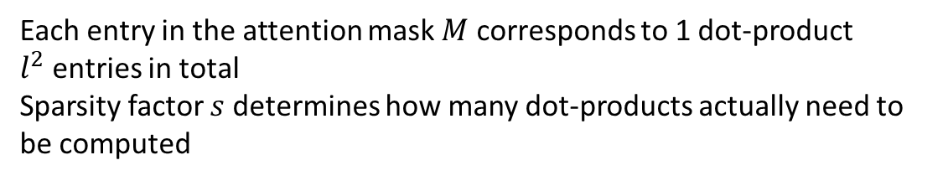

QK Product with Attention Mask
$$x_{1}$$
$$x_{2}$$
$$x_{3}$$
$$x_{L}$$
$$Q$$
$$K$$
$$x_{1}$$
$$x_{2}$$
$$q_{1}$$
$$x_{3}$$
$$q_{2}$$
$$q_{3}$$
$$L$$
X
$$k_{1}$$
$$k_{2}$$
$$k_{3}$$
$$x_{L}$$
Each entry in the attention mask $M$ corresponds to 1 dot-product
$l^{2}$ entries in total
Sparsity factor $s$ determines how many dot-products actually need to be computed
$$l$$
$$M$$

Slide 30














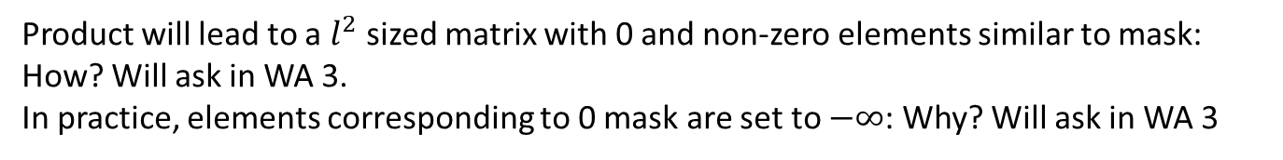



QK Product with Attention Mask
$$QK^{T}$$
$$x_{1}$$
$$x_{2}$$
$$x_{3}$$
$$x_{L}$$
$$x_{1}$$
$$x_{2}$$
$$x_{3}$$
$$x_{L}$$
$$x_{1}$$
$$x_{1}$$
$$x_{2}$$
$$x_{2}$$
$$x_{3}$$
$$x_{3}$$
$$x_{L}$$
$$x_{L}$$
Product will lead to a $l^{2}$ sized matrix with 0 and non-zero elements similar to mask: How? Will ask in WA 3.
In practice, elements corresponding to 0 mask are set to $−∞$: Why? Will ask in WA 3
$$M$$

Slide 31

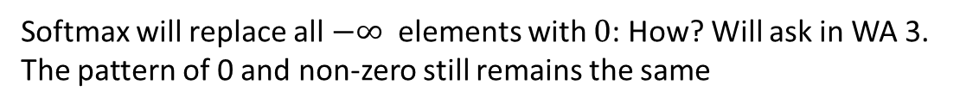
Softmax with Attention Mask
$$Z=softmax(QK^{T})$$
$$x_{1}$$
$$x_{2}$$
$$x_{3}$$
$$x_{L}$$
$$x_{1}$$
$$x_{2}$$
$$x_{3}$$
$$x_{L}$$
$$x_{1}$$
$$x_{1}$$
$$x_{2}$$
$$x_{2}$$
$$x_{3}$$
$$x_{3}$$
$$x_{L}$$
$$x_{L}$$
Softmax will replace all $−∞$ elements with $0$: How? Will ask in WA 3.
The pattern of 0 and non-zero still remains the same
$$M$$

Slide 32















Product with V Matrix
$$x_{1}$$
$$x_{2}$$
$$x_{3}$$
$$x_{L}$$
$$x_{1}$$
$$d_{v}$$
$$x_{2}$$
$$v_{1}$$
$$x_{3}$$
$$v_{2}$$
$$v_{3}$$
$$L$$
$$x_{L}$$
$$Z=softmax(QK^{T})$$
$$V$$
Product of a sparse matrix ($Z=softmax(QK^{T})$) and dense $V$ matrix

Slide 33
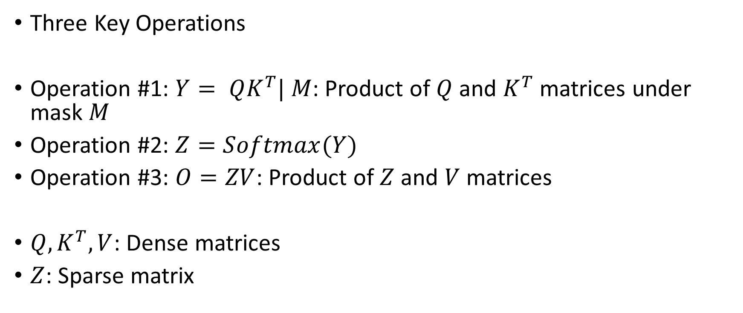
Attention with Sparse Attention Mask
Three Key Operations
Operation #1: $Y= QK^{T}| M$: Product of $Q$ and $K^{T}$ matrices under mask $M$
Operation #2: $Z=Softmax(Y)$
Operation #3: $O=ZV$: Product of $Z$ and $V$ matrices
$Q,K^{T}, V$: Dense matrices
$Z$: Sparse matrix

Slide 34
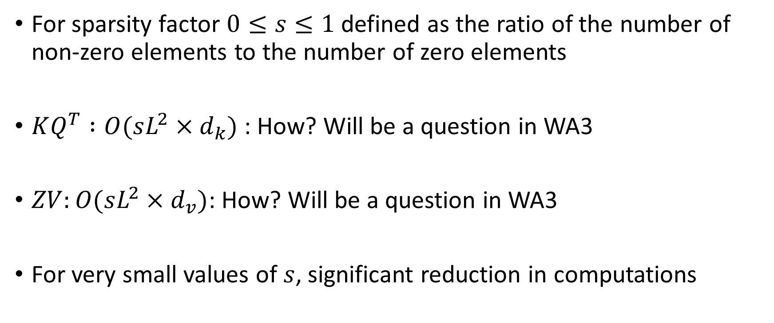
Theoretical Reduction in Computation
For sparsity factor $0≤s≤1$ defined as the ratio of the number of non-zero elements to the number of zero elements
$KQ^{T} :O(sL^{2}×d_{k})$: How? Will be a question in WA3
$ZV:O(sL^{2}×d_{v})$: How? Will be a question in WA3
For very small values of $s$, significant reduction in computations

Slide 35
Reduction in Computations
In practice, pytorch algorithms do not fully exploit this sparsity.
Recall our implementation that in the last question of Exam 1, it was not work-optimal
We will discuss this issue and potential solutions (some developed by my students) in the next class (or two)

Slide 36
Research on Sparse Transformers
Two main directions
#1 Build masks that reduce the computations but still preserve accuracy
Today’s class
#2 Exploit Sparsity on Hardware such as GPUs
Next one or two classes

Slide 37
Outline
Sparse Transformers Basics
Sparse Masks

Slide 38
Types of Attention Masks
Two main types
Dynamic Attention: Only consider query-key pairs for attending that are the most similar
No explicit attention mask
Pairs to attend determined at runtime
Static Attention: Fixed attention mask used to determine attending query-key pairs

Slide 39
Types of Attention Masks
Two main types
Dynamic Attention: Only consider query-key pairs for attending that are the most similar
No explicit attention mask
Pairs to attend determined at runtime
Static Attention: Fixed attention mask used to determine attending query-key pairs

Slide 40






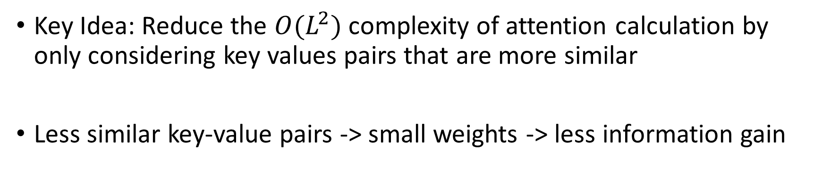









Reformer
Key Idea: Reduce the $O(L^{2})$ complexity of attention calculation by only considering key values pairs that are more similar
Less similar key-value pairs -> small weights -> less information gain
$$q_{1}.k_{1}$$
$$w_{1}$$
$$q_{1}$$
$$k_{1}$$
$$v_{1}$$
$$q_{1}.k_{2}$$
$$k_{2}$$
$$v_{2}$$
$$w_{2}$$
$$q_{2}$$
$$q_{1}.k_{3}$$
$$k_{3}$$
$$v_{3}$$
$$w_{3}$$
$$q_{L}$$
Kitaev, N., Kaiser, L., & Levskaya, A. (2019, September). Reformer: The Efficient Transformer. In International Conference on Learning Representations.

Slide 41
Reformer
How do we know what key-value pairs are more similar without computing the values???

Slide 42
Reformer
How do we know what key-value pairs are more similar without computing the values
Locality Sensitive Hashing

Slide 43
Locality Sensitive Hashing
A technique to perform efficient nearest neighbor search
Hashes “similar” items into same “buckets” with “high” probability

Slide 44
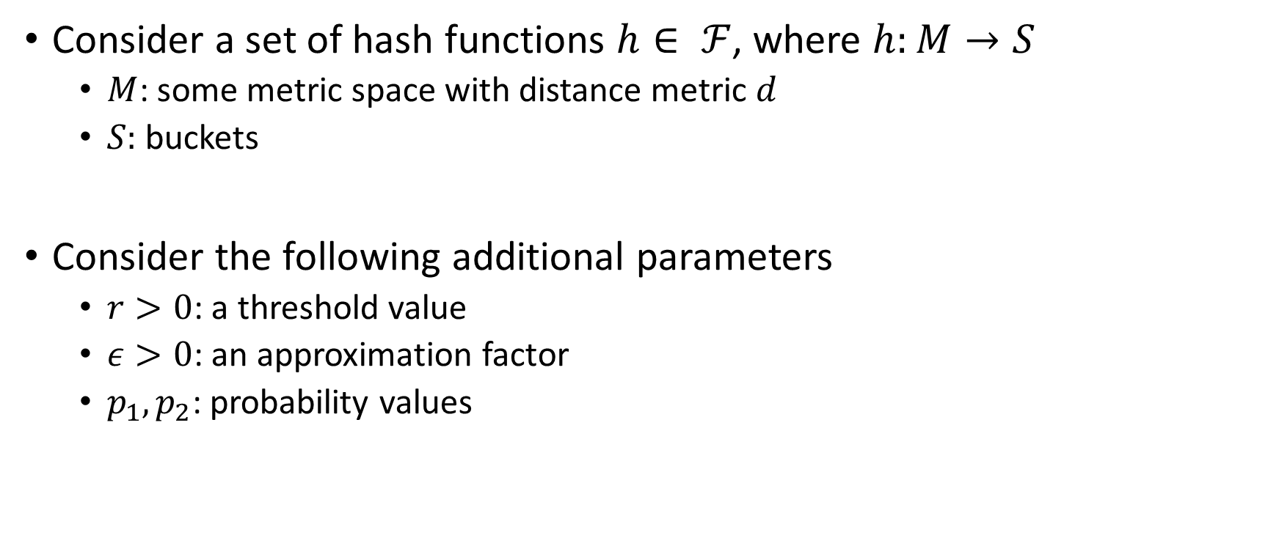
Locality Sensitive Hashing
Consider a set of hash functions $h∈ ℱ$, where $h:M→S$
$M$: some metric space with distance metric $d$
$S:$ buckets
Consider the following additional parameters
$r>0$: a threshold value
$ε>0$: an approximation factor
$p_{1}, p_{2}$: probability values

Slide 45
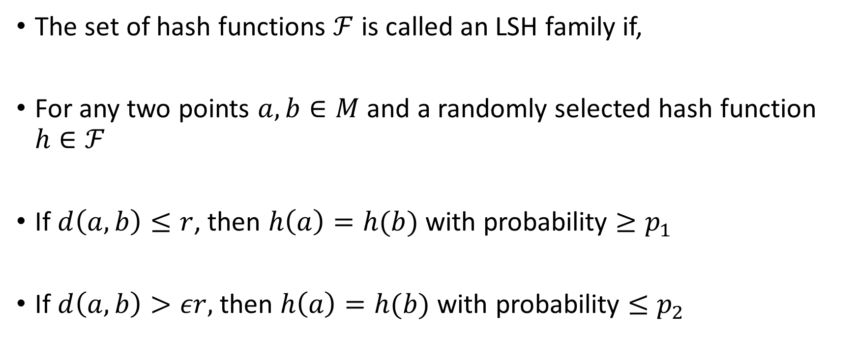
Locality Sensitive Hashing
The set of hash functions $ℱ$ is called an LSH family if,
For any two points $a,b∈M$ and a randomly selected hash function $h∈ℱ$
If $d\left(a,b\right)≤r$, then $h\left(a\right)=h(b)$ with probability $≥p_{1}$
If $d\left(a,b\right)>εr,$ then $h\left(a\right)=h(b)$ with probability $≤p_{2}$

Slide 46


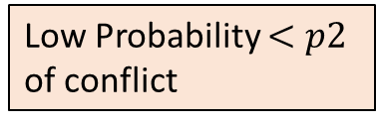
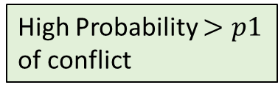

Locality Sensitive Hashing
High Probability $>p1$ of conflict
Low Probability $<p2$ of conflict
$$r$$
$$εr$$
$$M$$

Slide 47
Locality Sensitive Hashing
Key Design Parameters:
Determining the hash functions that can achieve this property
Look at this survey for more information: Jafari, Omid, Preeti Maurya, Parth Nagarkar, Khandker Mushfiqul Islam, and Chidambaram Crushev. "A survey on locality sensitive hashing algorithms and their applications." arXiv preprint arXiv:2102.08942 (2021).

Slide 48
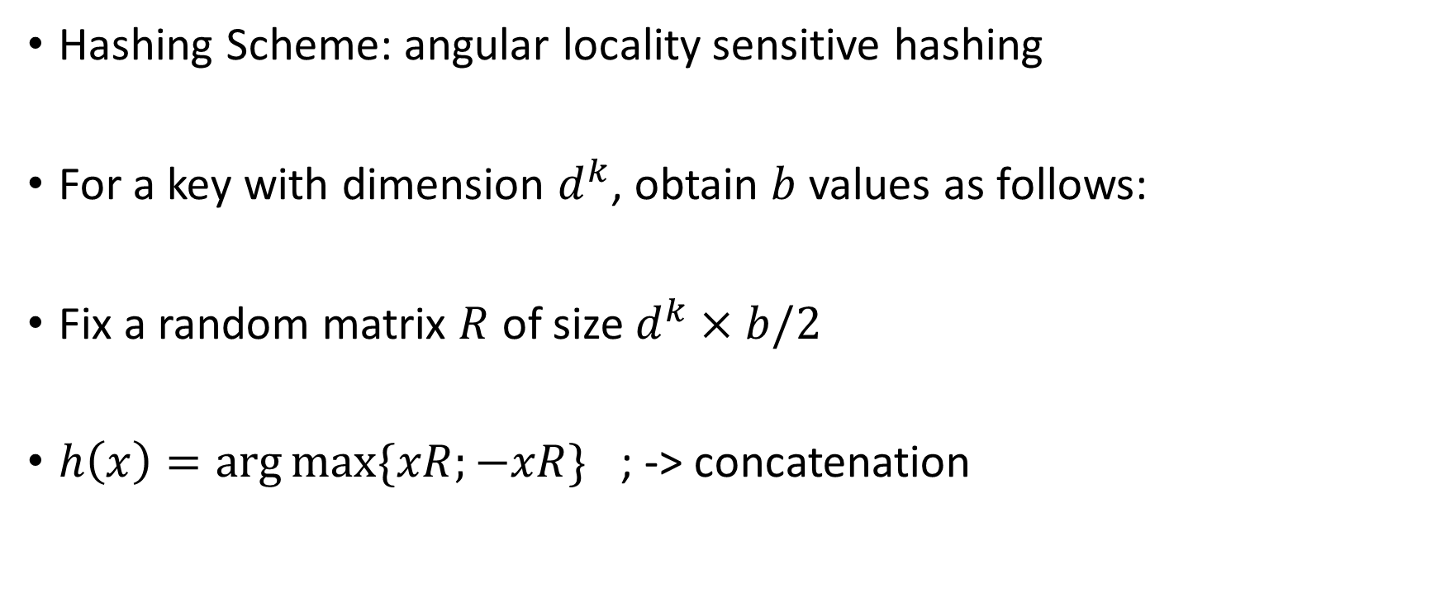
Reformer
Hashing Scheme: angular locality sensitive hashing
For a key with dimension $d^{k}$, obtain $b$ values as follows:
Fix a random matrix $R$ of size $d^{k}×b/2$
$h\left(x\right)=\arg{\max{\{xR;−xR\}}}$ ; -> concatenation

Slide 49
Reformer
Intuition: The dimension with largest value for points close to each other should be same even after projection.
For formal proof, and details on how to create the random matrix, and other parameters, see:
Andoni, A., Indyk, P., Laarhoven, T., Razenshteyn, I., & Schmidt, L. (2015). Practical and optimal LSH for angular distance. Advances in neural information processing systems, 28.

Slide 50








Reformer
Attention with LSH
Sparse adjacency matrix
However, inefficient for computation
Why???
$$x_{1}$$
$$x_{2}$$
$$x_{3}$$
$$x_{L}$$
$$x_{1}$$
$$x_{2}$$
$$x_{3}$$
$$x_{L}$$

Slide 51
Reformer
Attention with LSH
Sparse adjacency matrix
However, inefficient for computation
Too many random accesses
How do we fix???
$$x_{1}$$
$$x_{2}$$
$$x_{3}$$
$$x_{L}$$
$$x_{1}$$
$$x_{2}$$
$$x_{3}$$
$$x_{L}$$

Slide 52
Reformer
Attention with LSH
Sparse adjacency matrix
However, inefficient for computation
Too many random accesses
Sort the sequence to cluster buckets together
$$x_{1}$$
$$x_{2}$$
$$x_{3}$$
$$x_{L}$$
$$x_{1}$$
$$x_{2}$$
$$x_{3}$$
$$x_{L}$$

Slide 53
Reformer
Sort the sequence to cluster buckets together
Perform attention mechanism on blocks
Smaller matrix multiplications
(Make a note of this sorting technique, we will discuss more sophisticated methods in the next one/two classes)
$$x_{1}$$
$$x_{2}$$
$$x_{3}$$
$$x_{L}$$
$$x_{1}$$
$$x_{2}$$
$$x_{3}$$
$$x_{L}$$

Slide 54
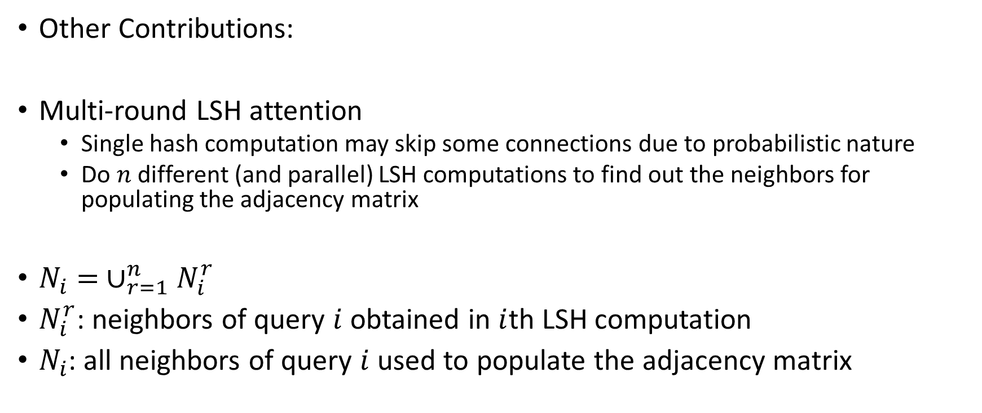
Reformer
Other Contributions:
Multi-round LSH attention
Single hash computation may skip some connections due to probabilistic nature
Do $n$ different (and parallel) LSH computations to find out the neighbors for populating the adjacency matrix
$N_{i}= ∪_{r=1}^{n}N_{i}^{r}$
$N_{i}^{r}$: neighbors of query $i$ obtained in $i$th LSH computation
$N_{i}$: all neighbors of query $i$ used to populate the adjacency matrix

Slide 55
Types of Attention Masks
Two main types
Dynamic Attention: Only consider query-key pairs for attending that are the most similar
No explicit attention mask
Pairs to attend determined at runtime
Static Attention: Fixed attention mask used to determine attending query-key pairs

Slide 56
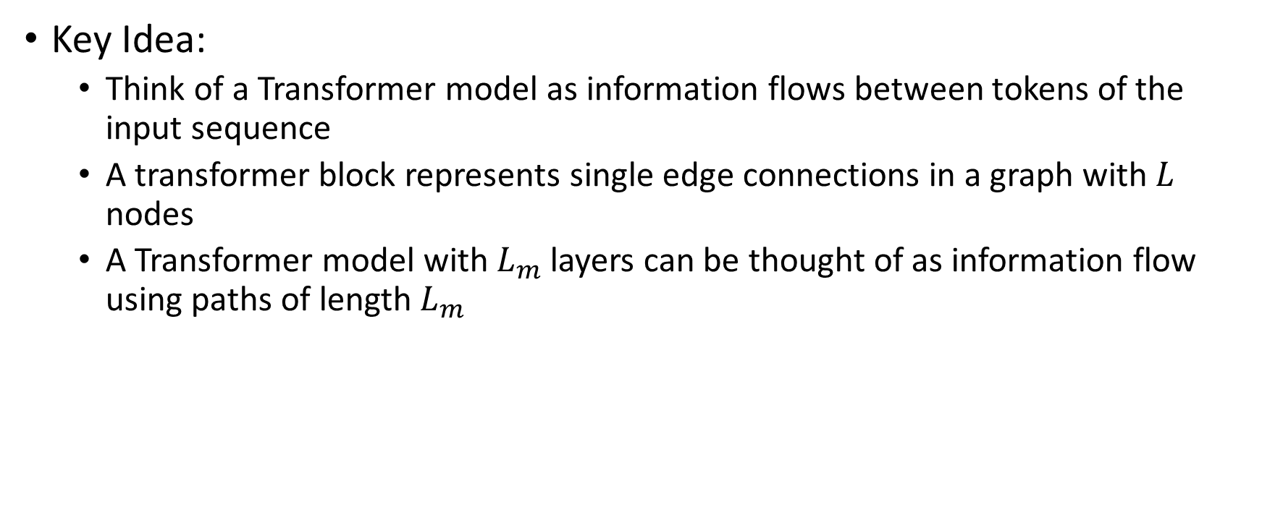
Big Bird
Key Idea:
Think of a Transformer model as information flows between tokens of the input sequence
A transformer block represents single edge connections in a graph with $L$ nodes
A Transformer model with $L_{m}$ layers can be thought of as information flow using paths of length $L_{m}$
Zaheer, M., Guruganesh, G., Dubey, K. A., Ainslie, J., Alberti, C., Ontanon, S., ... & Ahmed, A. (2020). Big bird: Transformers for longer sequences. Advances in neural information processing systems, 33, 17283-17297.

Slide 57




Big Bird
$$x_{2}$$
$$x_{3}$$
$$x_{1}$$
$$x_{4}$$
Transformer: Information flow between all tokens

Slide 58
Big Bird
$$x_{2}$$
$$x_{3}$$
$$x_{1}$$
$$x_{4}$$
Fully Connected Attention: Information flow between all tokens in Single Layer

Slide 59








Big Bird
Consider the following adjacency matrix for attention mechanism
Which two tokens have no information flow in a single layer?
$$x_{1}$$
$$x_{2}$$
$$x_{3}$$
$$x_{4}$$
$$x_{2}$$
$$x_{3}$$
$$x_{1}$$
$$x_{4}$$

Slide 60
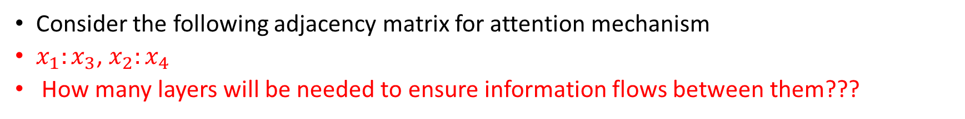
Big Bird
Consider the following adjacency matrix for attention mechanism
$x_{1}:x_{3}$, $x_{2}:x_{4}$
How many layers will be needed to ensure information flows between them???
$$x_{1}$$
$$x_{2}$$
$$x_{3}$$
$$x_{4}$$
$$x_{2}$$
$$x_{3}$$
$$x_{1}$$
$$x_{4}$$

Slide 61
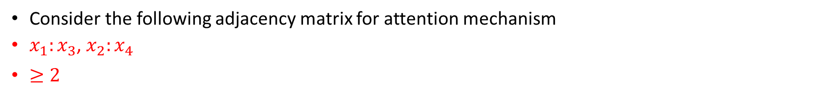
Big Bird
Consider the following adjacency matrix for attention mechanism
$x_{1}:x_{3}$, $x_{2}:x_{4}$
$≥2$
$$x_{1}$$
$$x_{2}$$
$$x_{3}$$
$$x_{4}$$
$$x_{2}$$
$$x_{3}$$
$$x_{1}$$
$$x_{4}$$

Slide 62
Big Bird
Consider the following adjacency matrix for attention mechanism
$x_{1}:x_{3}$, $x_{2}:x_{4}$
$≥2$
$$x_{1}$$
$$x_{2}$$
$$x_{3}$$
$$x_{4}$$
$$x_{2}$$
$$x_{3}$$
$$x_{1}$$
$$x_{4}$$

Slide 63
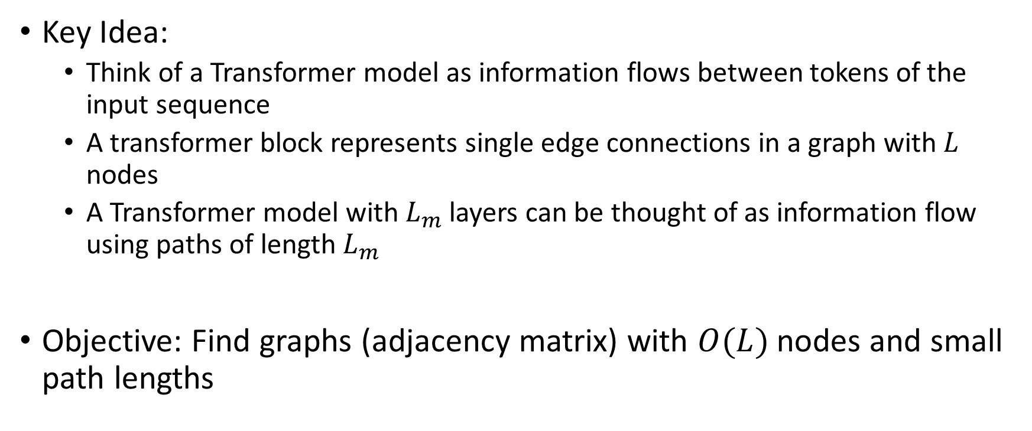
Big Bird
Key Idea:
Think of a Transformer model as information flows between tokens of the input sequence
A transformer block represents single edge connections in a graph with $L$ nodes
A Transformer model with $L_{m}$ layers can be thought of as information flow using paths of length $L_{m}$
Objective: Find graphs (adjacency matrix) with $O(L)$ nodes and small path lengths

Slide 64
Big Bird
Consists of three types of connections

Slide 65
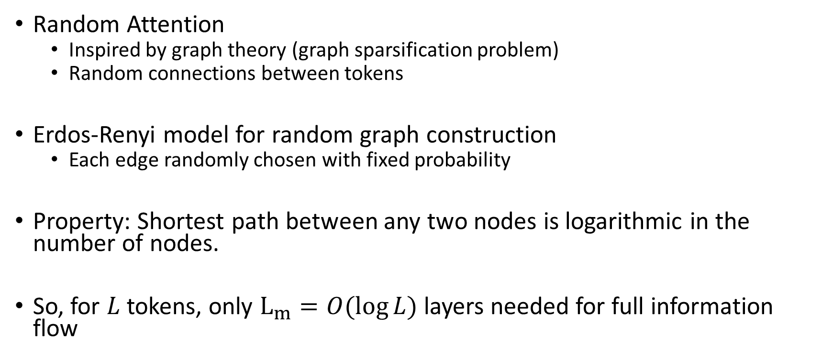
Big Bird
Random Attention
Inspired by graph theory (graph sparsification problem)
Random connections between tokens
Erdos-Renyi model for random graph construction
Each edge randomly chosen with fixed probability
Property: Shortest path between any two nodes is logarithmic in the number of nodes.
So, for $L$ tokens, only $L_{m}=O(\log{L})$ layers needed for full information flow

Slide 66
Big Bird
Random Attention: Select edges with a fixed probability

Slide 67

Big Bird
Windowed Attention:
Inspired from linguistics/computational biology
Sequences have locality of reference
$w$: window size is the key parameter

Slide 68

Big Bird
Global Attention: Marks some token as global (or add new tokens) and connects them to all the tokens in the sequence
Obtained using the theoretical analysis in the Reformer paper
$g:$ number of global tokens is the key parameter

Slide 69

Big Bird
Combining everything, we get
$O(L)$ connections – proof in the paper. We will not discuss here.

Slide 70
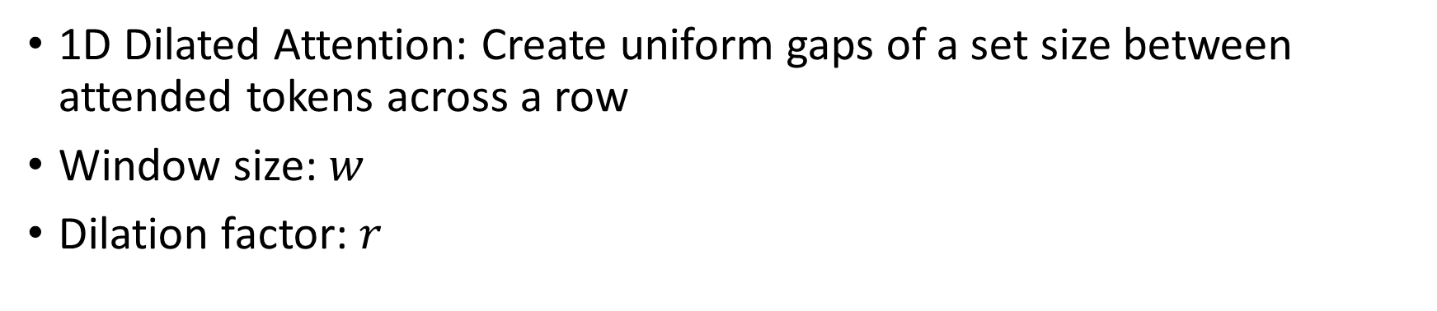
Other Attention Patterns
1D Dilated Attention: Create uniform gaps of a set size between attended tokens across a row
Window size: $w$
Dilation factor: $r$
I. Beltagy, M. E. Peters, and A. Cohan, “Longformer: The longdocument
transformer,” arXiv preprint arXiv:2004.05150, 2020

Slide 71
Other Attention Patterns
2D Dilated Attention: Dilation along both dimensions
Probability of query and key attending exponentially reduces with distance between the corresponding tokens
J. Ding, S. Ma, L. Dong, X. Zhang, S. Huang, W. Wang, N. Zheng, and F. Wei, “Longnet: Scaling transformers to 1,000,000,000 tokens,” 2023. [Online]. Available: https://arxiv.org/abs/2307.02486

Slide 72
Other Attention Patterns
2D Dilated Attention
Understand the equation
May ask a question in WA 3

Slide 73
Next Class
10/30 Lecture 18
Accelerating Transformer Model: Sparse Transformers II
Hardware Acceleration of Sparse Transformers

Slide 74
Thank You
Questions?
Email: sanmukh.kuppannagari@case.edu

